Slide 1
ESE 3002 PROJECT PREPARATION Chandra Shekar Reddy Saga(c0747253)
(Internet Of Things device)
Smart door bell camera

Slide 2
Introduction
Internet of Things (IoT) :These devices works with the support of internet, artificial intelligence technology like computers.
These devices can also be operated from remote places.
Today we have the devices which can work on 5G network.

Slide 3
Flow chart
deploy
monitor
service
manage
Update
decommission

Slide 4
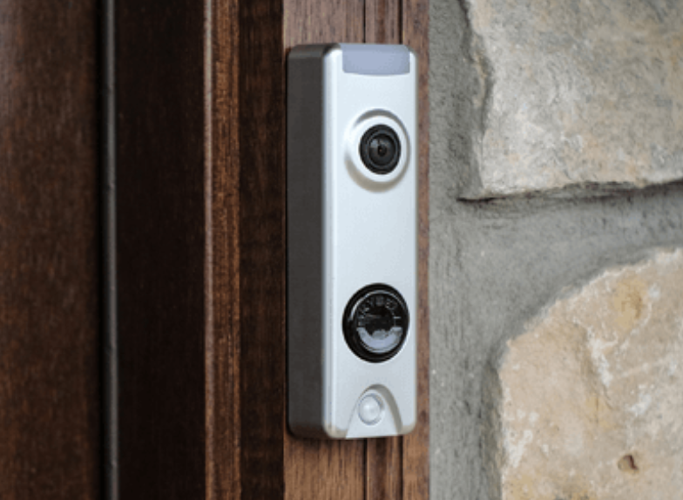
Wireless Doorbell camera.

Slide 5
Block diagram
Image sensing
Video acquisition
Application specific information processing
display

Slide 6
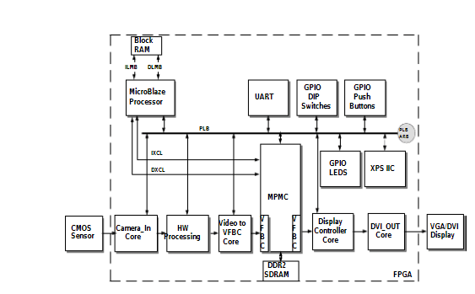
Architecture of smart camera (FPGA)

Slide 7

Smart door bell camera works on mainly two things 1)sensor
2)filed programmable gate array(FPGA)
This camera not only takes the pictures but also smart and appropriate decisions can be taken.
24*7 surveillance on work place or home.

Slide 8
Advantages:
1.No wires are needed for connections.
2.Flexibulity to move from one place to another.
3.We can save footage directly to cloud.
Disadvantages:
1.Internet should be needed all the time.
2.Wireless systems can be easily hacked.
3.They need to be charged or continuous power supply should be needed.

Slide 9
Conclusion
In this modern era IOT devices are very much useful to mankind to make the work simple and secure.
Even though there are some disadvantages it can be overcome by new technologies.

Slide 10


Slide 11
References:
4 Disadvantages and Advantages of Installing a Wireless Security. (2018, October 12). Retrieved from https://www.aeonsystems.net/advantages-disadvantages-wireless-security-system/
https://www.researchgate.net/figure/Block-diagram-of-smart-camera-system_fig1_236624040

